Slide 1

Computer Vision & Convolutional Neural Networks
with

Slide 2
“What is a computer vision problem?”

Slide 3
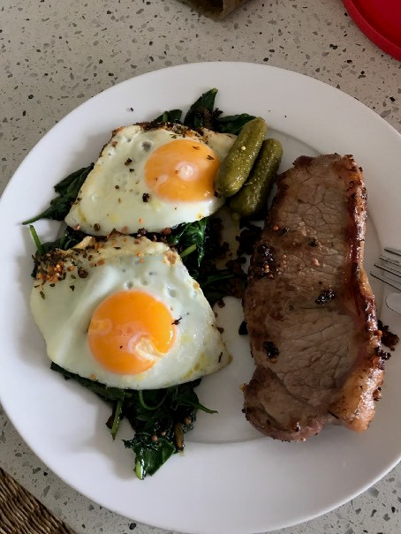
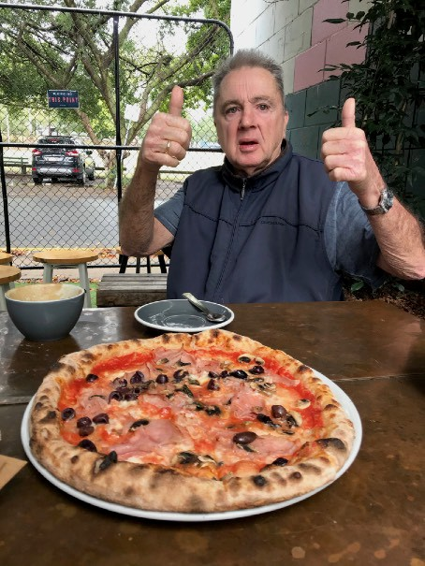
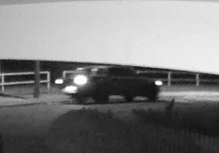
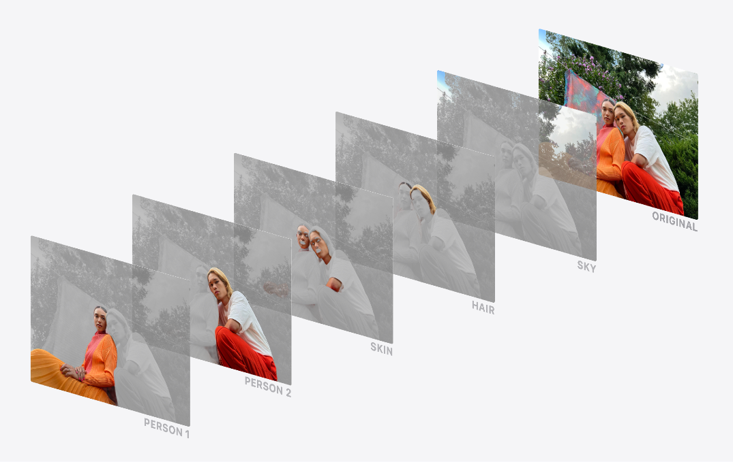
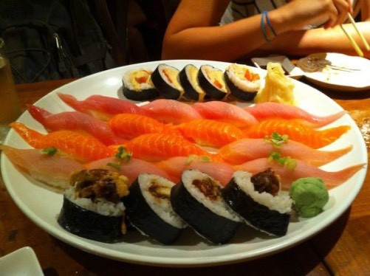
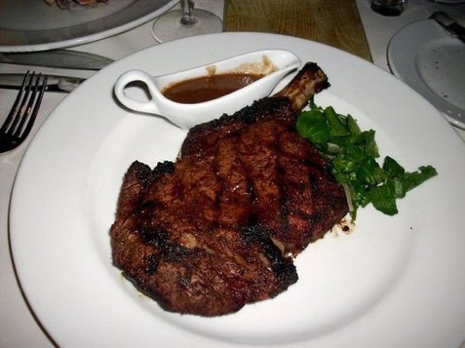
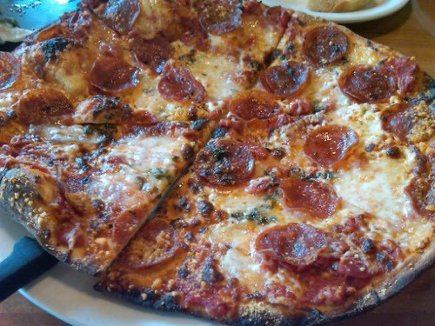
Example computer vision problems
“Is this a photo of steak or pizza?” “Where’s the thing we’re looking for?”
Binary classiKcation
Object detection
“What are the diferent sections in this image?”
(one thing or another)
“Is this a photo of sushi, steak or pizza?”
Multiclass classification
(more than one thing or
Segmentation
Source: On-device Panoptic Segmentation for Camera Using Transformers.
another)

Slide 4

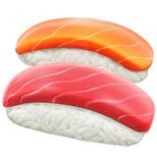
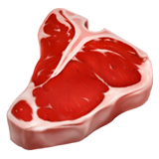
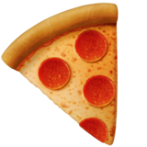
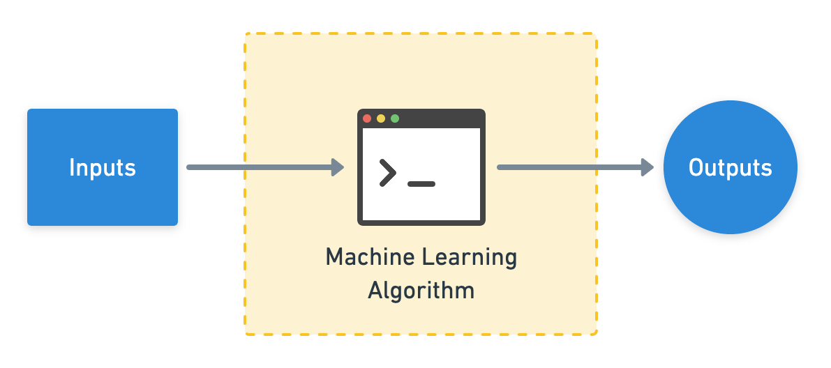


Computer vision inputs and outputs
224
W = 224
H = 224
C = 3
224
Sushi
Steak
Pizza
Actual output
(c = colour channels, R, G, B)
This is often a convolutional neural network (CNN)!
[[0.31, 0.62, 0.44…],
[[0.97, 0.00, 0.03],
[0.92, | 0.03, | 0.27…], | [0.81, | 0.14, | 0.05],
[0.25, | 0.78, | 0.07…], | [0.03, | 0.07, | 0.90],
…, |  |  | …,
(normalized pixel values)
Numerical encoding
Predicted output
(often already exists, if not,
(comes from looking at lots
you can build one)
of these)

Slide 5
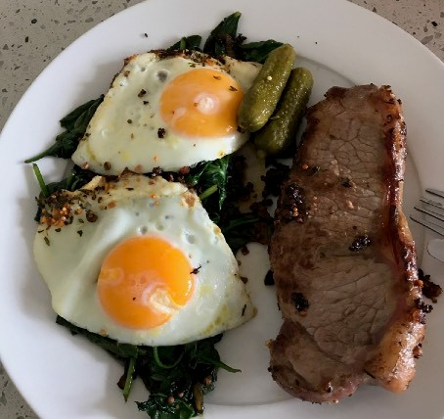
Input and output shapes
We’re going to be building CNNs to do this part!
(for an image classification example)
224
[[0.31, 0.62, 0.44…],
224
[0.92, 0.03, 0.27…],
[0.25, 0.78, 0.07…],
…,
[0.00, 0.97, 0.03]
(prediction probabilities)
(gets represented as a tensor)
[batch_size, width, height, colour_channels]
Shape = [3]
Shape = [None, 224, 224, 3]
or
Shape = [32, 224, 224, 3]
These will vary depending on the problem you’re working on.
(32 is a very common batch
size)

Slide 6
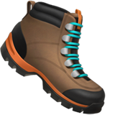

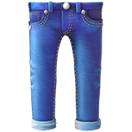
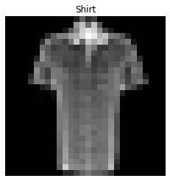
Input and output shapes
28
(gets represented as a tensor)
…
[[0.00, 0.62, 0.44…],
28
[0.00, 0.03, 0.27…],
[0.01, 0.78, 0.07…],
…,
[0.00, 0.97, …]
(prediction probabilities)
[batch_size, height, width, colour_channels] (NHWC)
or
[batch_size, colour_channels, height, width] (NCHW)
(colour channels last)
Shape = [10]
(colour channels first)
Shape = [None, 28, 28, 1] (NHWC)
Shape = [None, 1, 28, 28] (NCHW)
or
Shape = [32, 28, 28, 1]
These will vary depending on the problem you’re working on.
(32 is a very common batch size)

Slide 7
“What is a convolutional neural network (CNN)?”

Slide 8
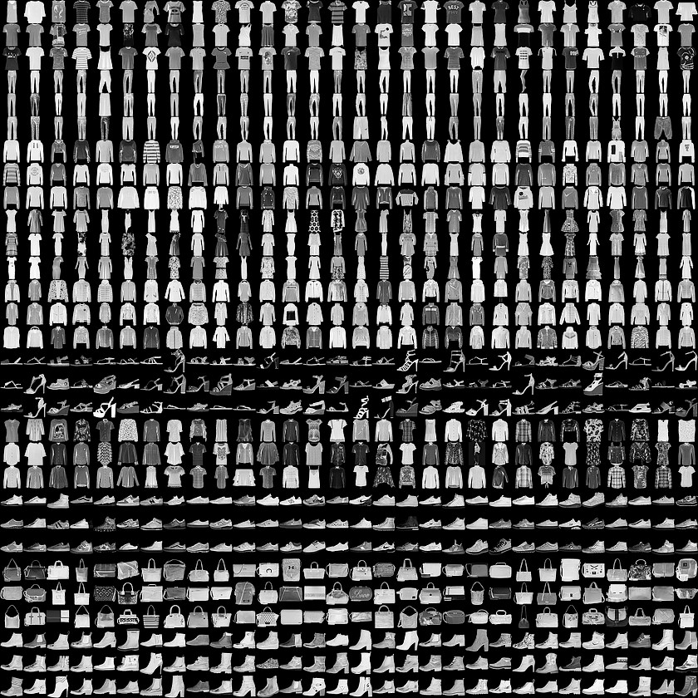
FashionMNIST
“What type of clothing is in this image?”
Multiclass classiKcation
(more than one thing or
another)
torchvision.datasets.FashionMNIST

Slide 9
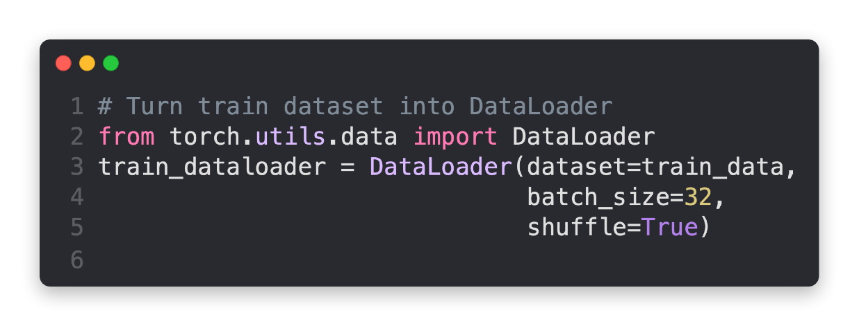
FashionMNIST: Batched
batch_size=32
(32 samples per batch)
Sample 0 1 2
3 4 5 32
Batch
0
…
1
…
2
…
torch.utils.data.DataLoader
…
3
4
…
torchvision.datasets.FashionMNIST
shuffle=True
(samples all mixed up)
Num samples/ batch_size
…

Slide 10
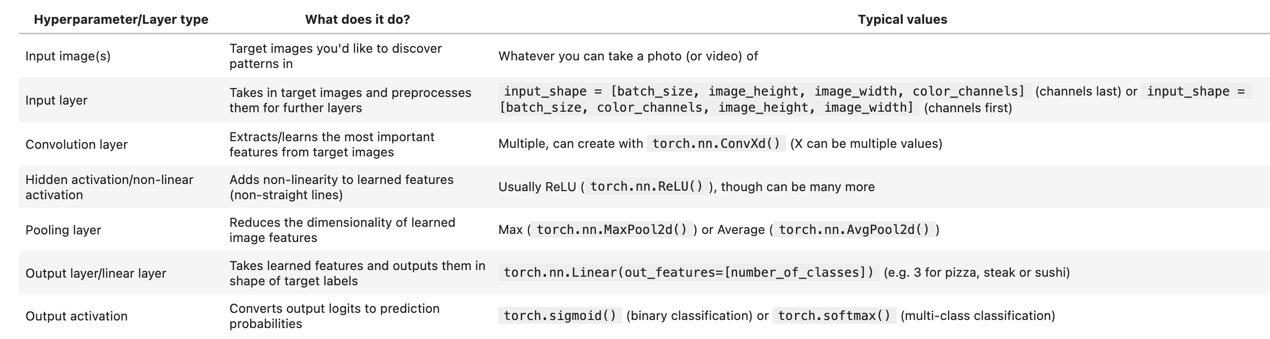
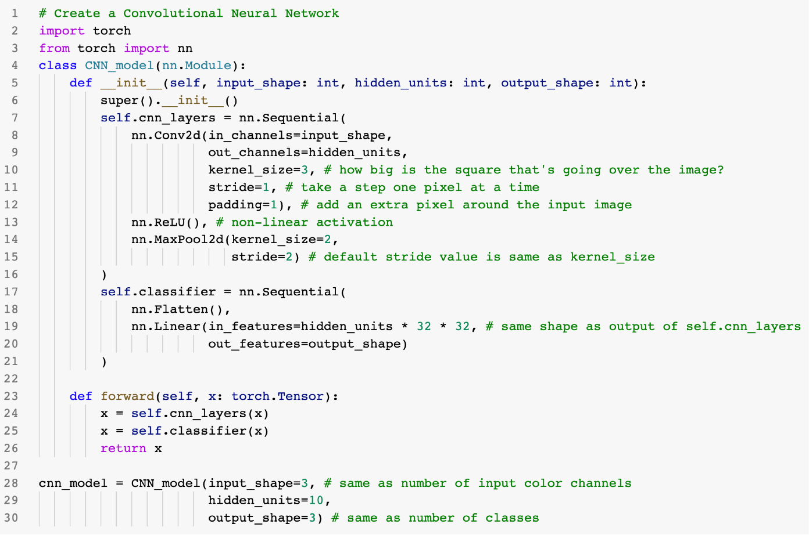
Architecture of a CNN
(typical)*
(what we’re working towards
building)
Steak
Pizza
Sushi
*Note: there are almost an unlimited amount of ways you could stack together a convolutional neural network, this slide demonstrates only one.

Slide 11
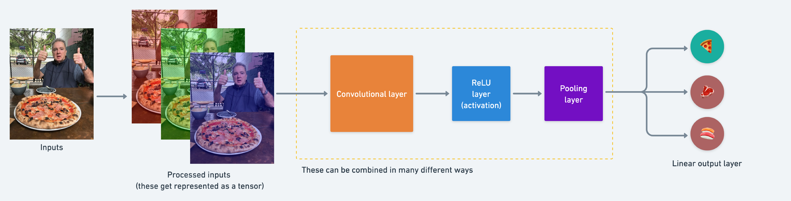
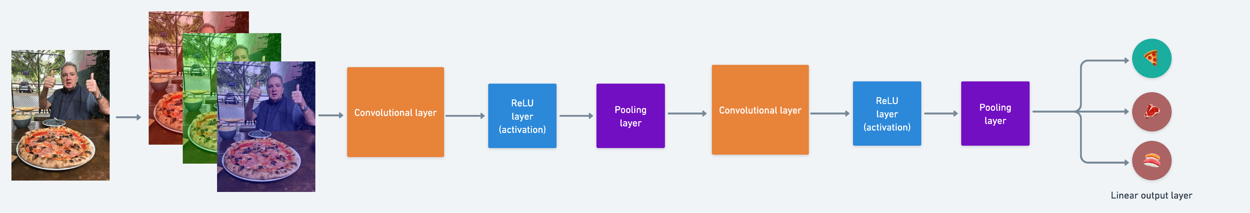
Typical architecture of a CNN
Simple CNN
(coloured block edition)
Deeper CNN

Slide 12
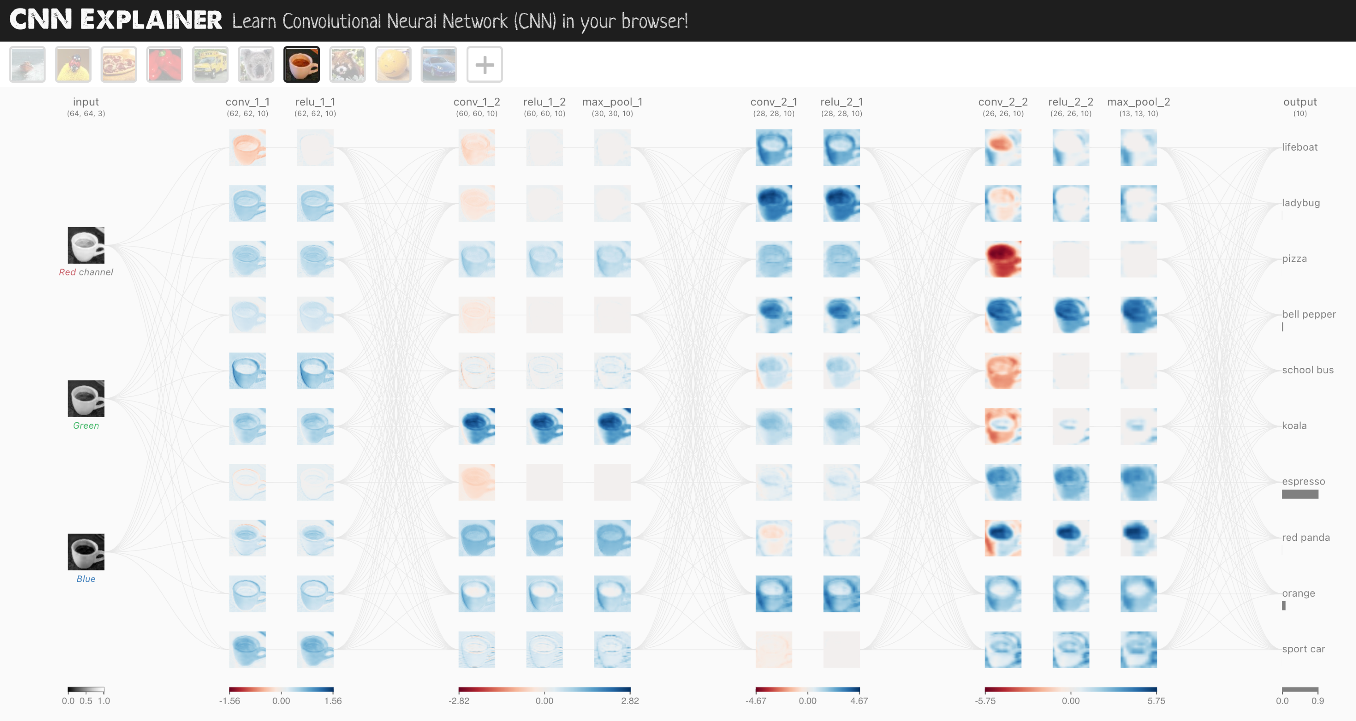
CNN Explainer model
Input layer
Conv2d layers ReLU activation layers Pooling layers
Output layer
Source: CNN Explainer website, architecture is known as TinyVGG.

Slide 13
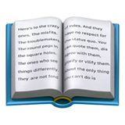
Breakdown of torch.nn.Conv2d layer
Example code: torch.nn.Conv2d(in_channels=3, out_channels=10, kernel_size=(3, 3), stride=(1, 1), padding=0)
Example 2 (same as above): torch.nnConv2d(in_channels=3, out_channels=10, kernel_size=3, stride=1, padding=0)
Hyperparameter name | What does it do? | Typical values
in_channels | Defines the number of input channels of the input data. | 1 (grayscale), 3 (RGB color images)
_{out_channels} Defines the number output channels of the layer (could _{10, 128, 256, 512} also be called hidden units). kernel_size (also referred to as Determines the shape of the kernel (sliding windows) over 3, 5, 7 (lowers values learn smaller _{`lter size) the input.} features, higher values learn larger features) The number of steps a filter takes across an image at a stride time (e.g. if strides=1, a filter moves across an image 1 1 (default), 2 pixel at a time). Pads the target tensor with zeroes (if “same”) to preserve padding input shape. Or leaves in the target tensor as is (if 0, 1, “same”, “valid” “valid”), lowering output shape.
Resource: For an interactive demonstration of the above hyperparameters, see the CNN Explainer website.

Slide 14
torchvision.transforms torch.utils.data.Dataset
torch.utils.data.DataLoader
torch.save torch.load
torchmetrics
torch.optim
torch.nn torch.nn.Module torchvision.models
torch.utils.tensorboard
See more: https://pytorch.org/tutorials/beginner/ptcheat.html

Slide 15
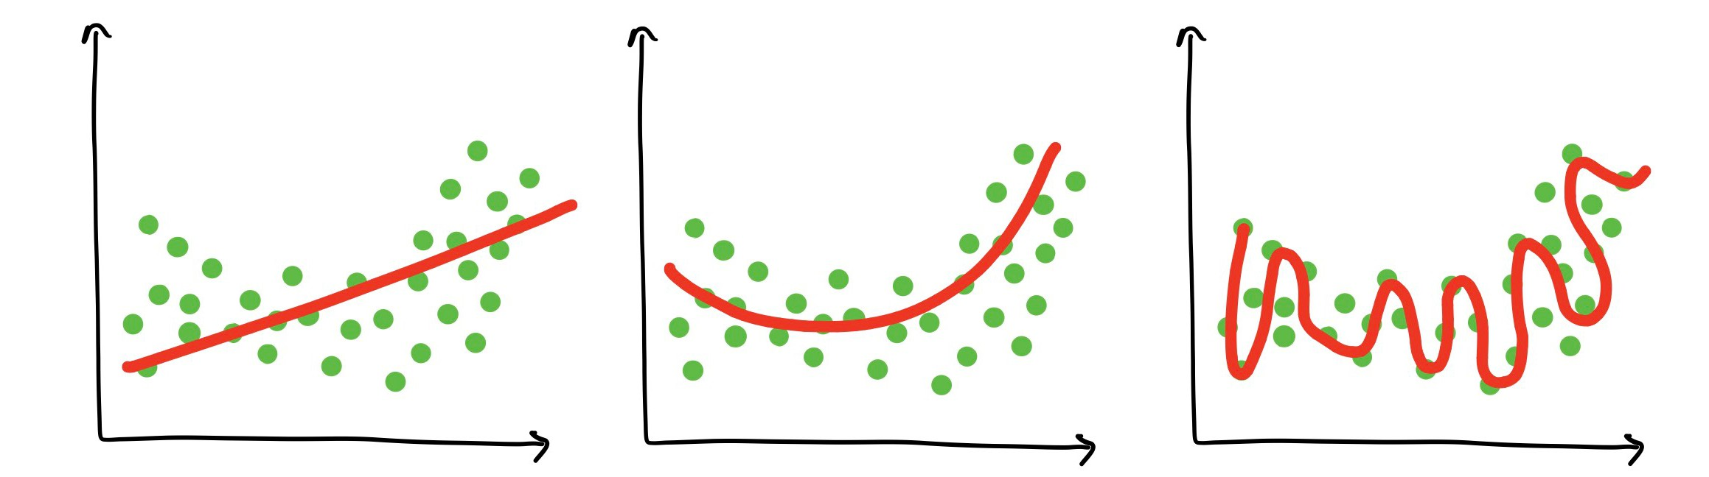
What is overfitting?
Over[tting — when a model over learns patterns in a particular dataset and isn’t able to generalise to unseen data.
For example, a student who studies the course materials too hard and then isn’t able to perform well on the Knal exam. Or tries to put their knowledge into practice at the workplace and Knds what they learned has nothing to do with the real world.
Under[tting
Balanced
(goldilocks zone)
Over[tting

Slide 16
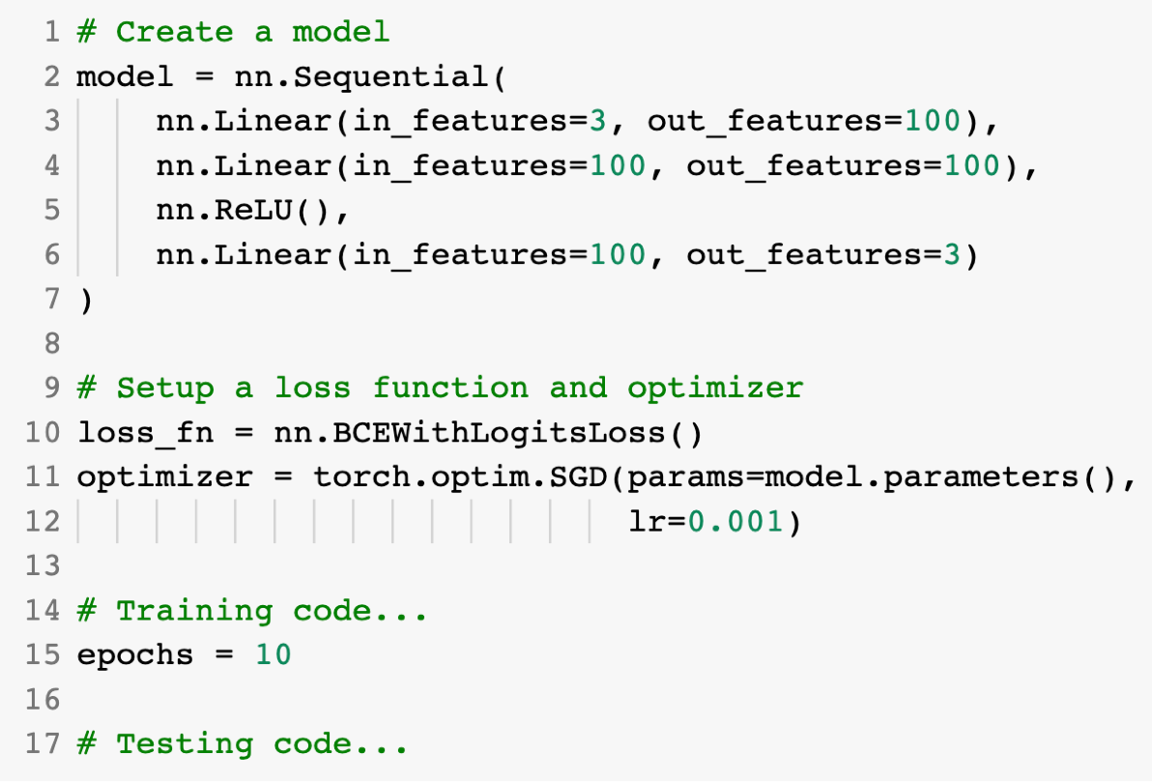
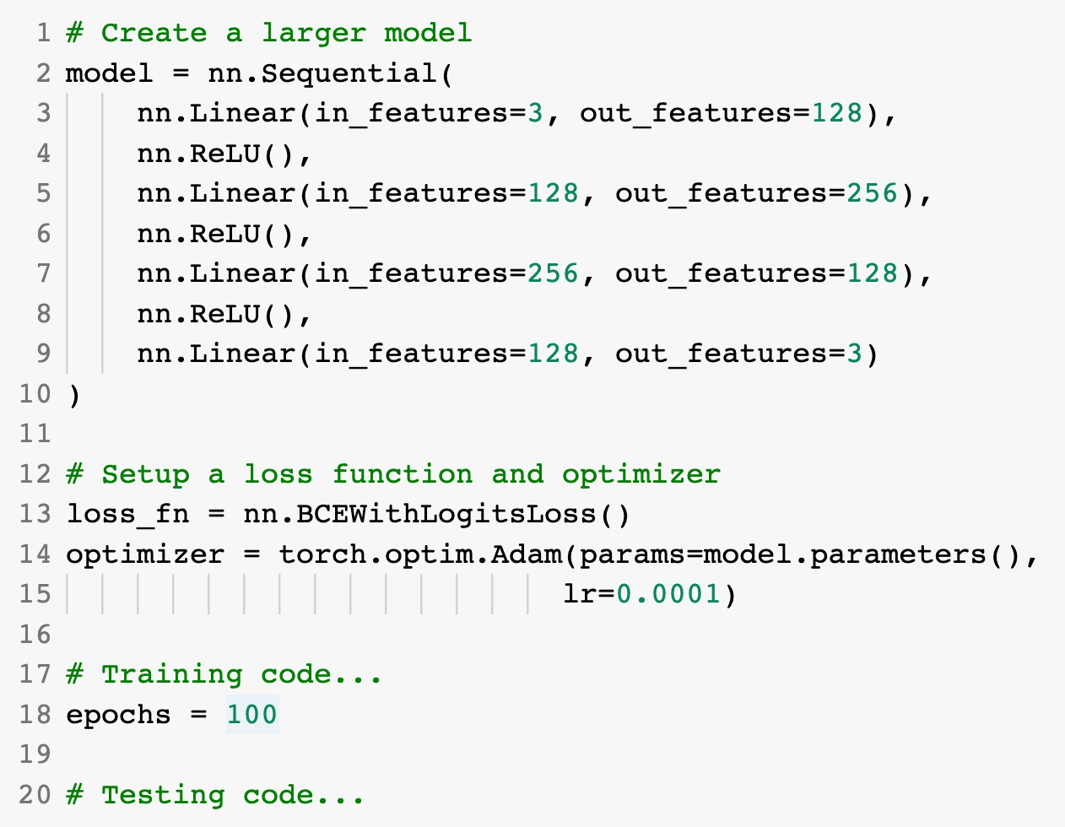
Improving a model
(from a model’s perspective)
Smaller model
Common ways to improve a deep model:
Adding layers
Increase the number of hidden units
Change/add activation functions
Larger model
Change the optimization function
Change the learning rate
(because you can alter each of
Fitting for longer
these, they’re hyperparameters)

Slide 17
Improving a model
(from a data perspective)
Method to improve a model (reduce over[tting)
What does it do?
Gives a model more of a chance to learn patterns between samples (e.g. if a model is performing poorly on images of pizza, show it more images of pizza).
More data
Increase the diversity of your training dataset without collecting more data (e.g. take your photos of pizza and randomly rotate them 30°).
Increased diversity forces a model to learn more generalisation patterns.
Data augmentation
Not all data samples are created equally. Removing poor samples from or adding better samples to your dataset can improve your model’s performance.
Better data
Take a model’s pre-learned patterns from one problem and tweak them to suit your own problem. For example, take a model trained on pictures of cars to recognise pictures of trucks.
Use transfer learning

Slide 18
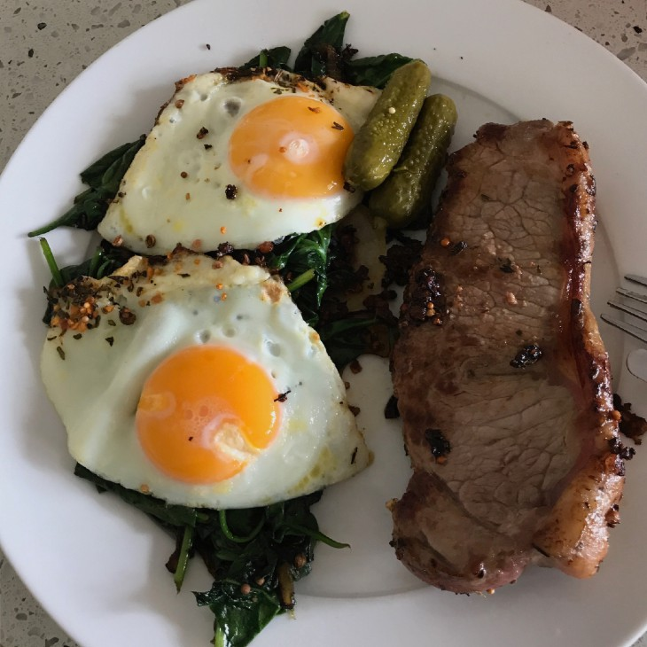
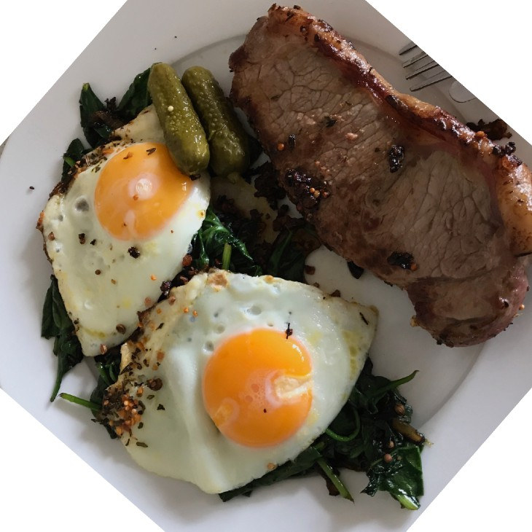
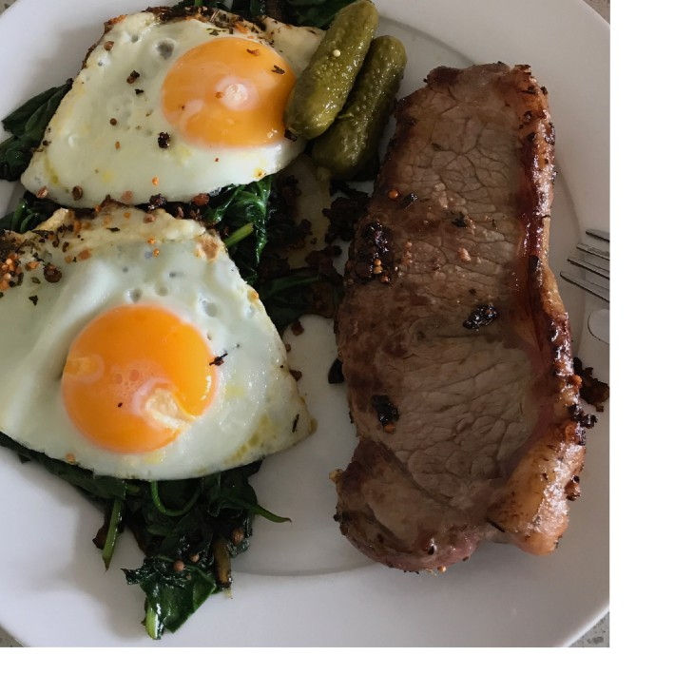
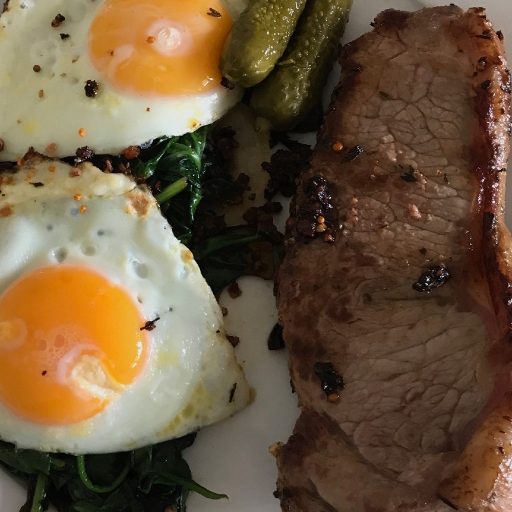
What is data augmentation?
Looking at the same image but from diferent perspective(s)*.
Original
Rotate
Shift
Zoom
*Note: There are many more di;erent kinds of data augmentation such as, cropping, replacing, shearing. This slide only demonstrates a few.

Slide 19




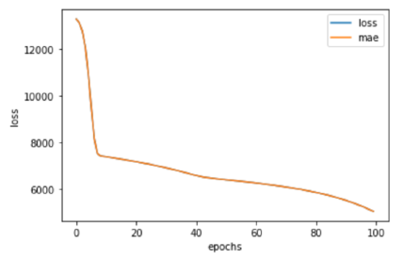
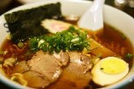
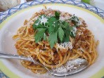
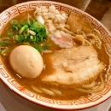
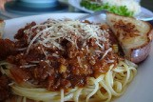
The machine learning explorer’s motto
“Visualize, visualize, visualize”
Data
Model
It’s a good idea to visualize these as often as possible.
Training
Predictions

